Slide 1
Problem Statement
Findings From interview
People were excited about our project
Social media was the source of information
Facebook and twitter
Type of information people post is secondary

Slide 2
Problem Statement
Findings From interview
Our Assumption went wrong
most of people will have twitter Account
Consider news biased towards
Follow web pages of different news channels
Post information related to technology, politics and personal affairs on social sites

Slide 3
Problem Statement
ti
Value Proposition
Unbiased news
people will able to see actual picture
Save time
time is the most important entity nowadays
personalize news
No need to see irrelevant content

Slide 4

Citizen Journalism

Slide 5

Citizen Journalism

Slide 6

Citizen Journalism

Slide 7
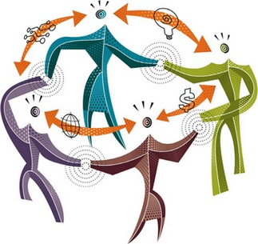
Team Members:
Ayesha Asghar 13033
Zeeshan Muzammal 13010
Abdul Monam 13039
Arslam Ahmed 13023

Slide 8

Overview
Problem Statement
Need Finding
Findings from interviews
Solution
Value proposition
Prototype
Testing Phase

Slide 9
Problem Statement
Problem Statement
Sources of information
Newspaper
Social Media
News Channels
Biased News
Conflicting Results
Wastage of time

Slide 10
Problem Statement
Need Finding Methodology
Identify Stakeholders
Made Questionnaire
Interview 10 people
Interviews people age between 20-28

Slide 11
Problem Statement
Why We choose these people
People from diverse background
Diverse point of views
Mostly people of this group are more active on social sites
Know importance of their point of view

Slide 12
Problem Statement
Findings From interview
They were very critical against the behavior of current news channels
During question related to TV channels they get hyper against politician
Their behavior was friendly
They were using laptop and mobile.
We infer they want un-biased news from some source

Slide 13
Problem Statement
Findings From interview
Our Assumption went wrong
most of people will have twitter Account
Social media was the source of information
Facebook and twitter
Type of information people post is secondary

Slide 14
Problem Statement
ti
Solution
Brainstorm solutions
Select 3 best solutions
using those 3 mini solutions we come up with final solution
Providing an mobile app that will provide news using tweets of people anchor and news channels. User can also make his profile there to get news related to his/her interest that will be helpful to save his\her time. It will give news ‘ comparison with other news channels at the same time, that will show the biasness factor if there is any.

Slide 15
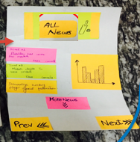
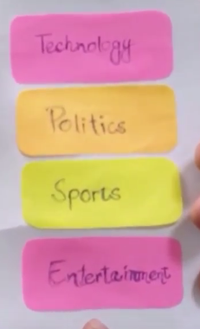
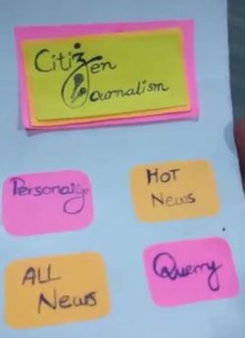
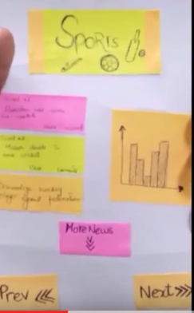
Problem Statement
ti
Low-Fi Prototype

Slide 16
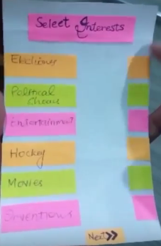
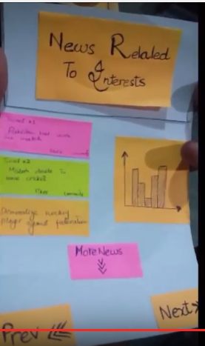
Problem Statement
ti
Low-Fi Prototype

Slide 17
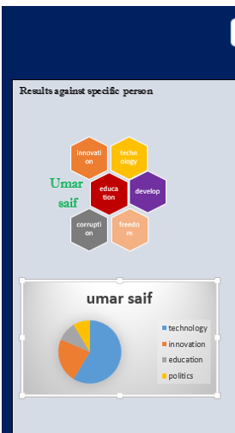
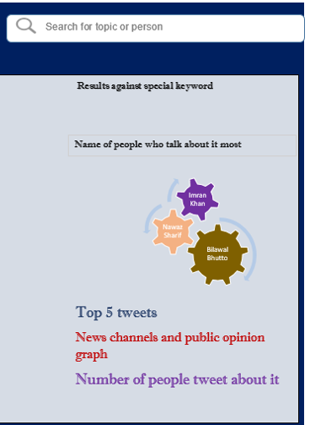
Problem Statement
ti
Low-Fi Prototype

Slide 18
Problem Statement
ti
Testing phase
Heuristic Evaluation (Nielsen Rules)
Tested with Six users
Tested with same people whom we interview
Tested at their work place
Were happy to see low fidelity after interviews

Slide 19
Problem Statement
ti
Things That Work
Like news presented in graphs
They like personalized news’s part in prototype
Make no errors almost while using mockups
Create log in easily using mockups

Slide 20
Problem Statement
ti
Things Didn’t Work
Were not much comfortable with heavy texts
Want concise form of news extracted from those tweet
Want more graphical interface

